Slide 1
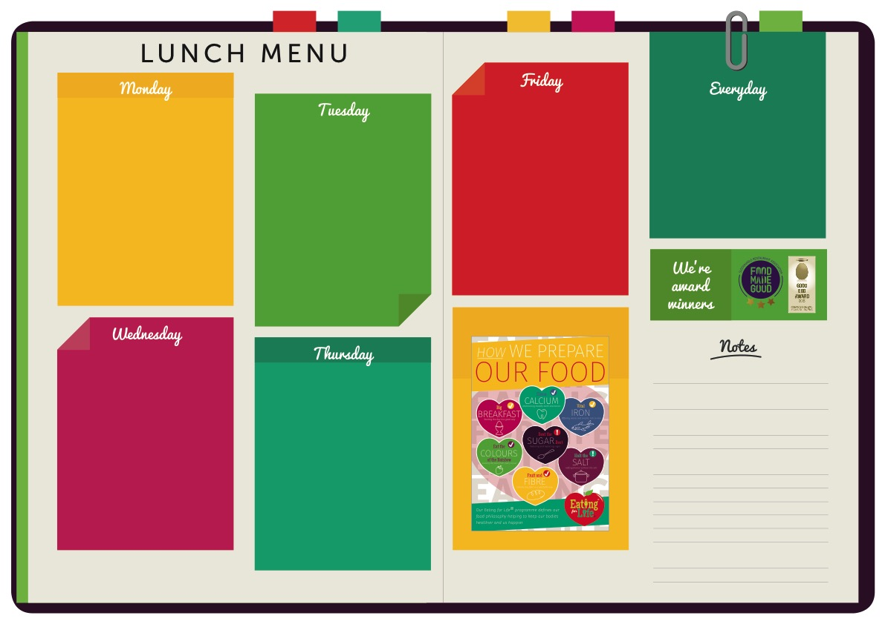
MAIN
Creamy Tomato & Spinach Sauce
MEAT FREE
Roasted Vegetables With Herbed Cous Cous
TO GO WITH
Pasta Shells
Green Beans
MAIN
Cheese & Ham Muffin
MEAT FREE
Cheese & Onion Pastry Roll
TO GO WITH
Crispy Chips
Mixed Salad
Selection of Salads
Soup Of The Day
Home-made Bread
Jacket Potato
Yoghurts
Fresh Fruit
Dessert of the Day
MAIN
Chicken Korma
MEAT FREE
Butternut Squash & Red Lentil Curry
TO GO WITH
Basmati Rice
Baton Carrots
MAIN
Minced Beef & Onion Pie
MEAT FREE
Mediterranean Vegetable Casserole
TO GO WITH
Mashed Potatoes
Cauliflower & Broccoli
MAIN
Greek Shepherds Pie
MEAT FREE
Spinach & White Bean Enchilladas
TO GO WITH
Peas
AUTUMN/ WEEK ONE

