Slide 1
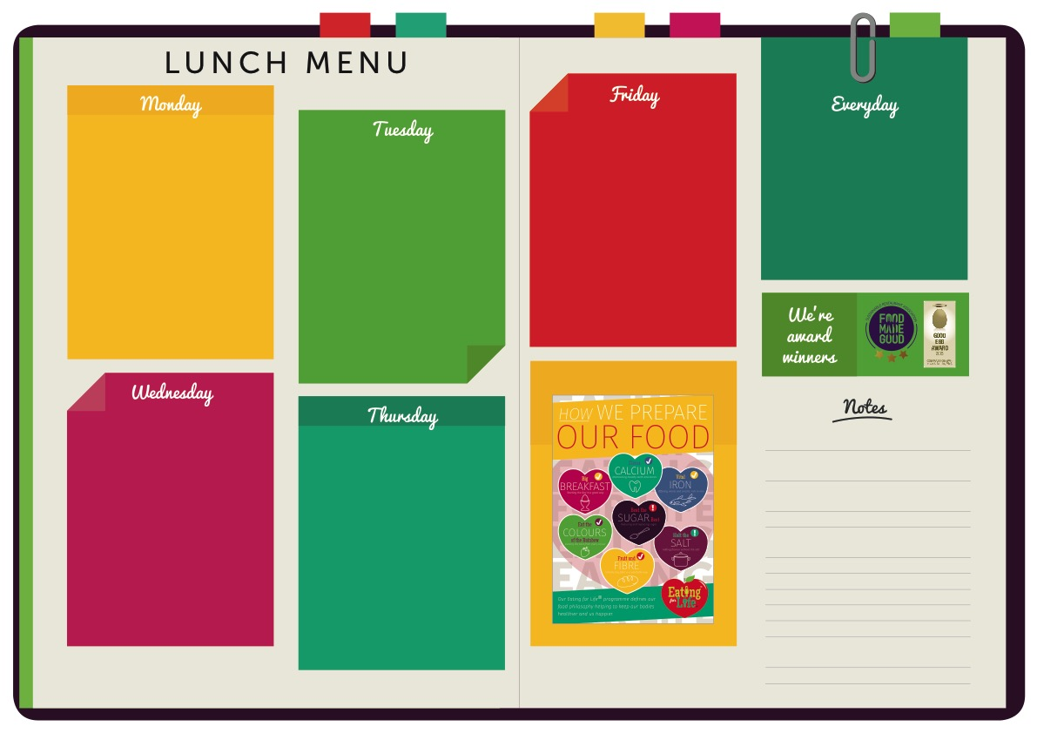
MAIN
Macaroni Cheese
MEAT FREE
Tomato & Basil Sauce
TO GO WITH
Penne Pasta
Peas
MAIN
Pepperoni Pizza
MEAT FREE
Cheese & Tomato Pizza
TO GO WITH
Potato Wedges
Carrot & Cucumber Sticks
Home-made Bread
Jacket Potato
Yoghurts
Fresh Fruit
Dessert of the Day
MAIN
Chicken Tikka Masala
MEAT FREE
Quorn Ratatouille
TO GO WITH
Basmati Rice
Broccoli
MAIN
Toad In The Hole
MEAT FREE
Vegetarian Toad In The Hole
TO GO WITH
Mashed Potatoes
Savoy Cabbage & Carrots
MAIN
Beef Meatballs In Tomato Sauce
MEAT FREE
Vegetarian Meatballs In Tomato Sauce
TO GO WITH
Spaghetti
Green Beans
WINTER/ WEEK ONE

